Slide 1

PMG 4101
Project Management
Dr. Suman Ahmmed, CSE, UIU

Slide 2


Topics:
Risk Plan Approach
Risk Management Method – RMMM
Supported By
Supported By
Powered By
Powered By

Slide 3
Risk Management
Supported By
Powered By

Slide 4
Risk Management
Risk analysis and management are actions that help a software team to understand and manage uncertainty.
A risk is a potential problem—it might happen, it might not. But, regardless of the outcome, it’s a really good idea to Identify it, assess its probability of occurrence, estimate its impact, and establish a contingency plan if the problem actually occur.
Supported By
Powered By

Slide 5
Risk Plan
A risk plan is a list of all risks that threaten the project, along with a plan to mitigate some or all of those risks. Each of the risks in the plan must be assessed by the project manager and the team. Risk assessment is an important part of planning a software project because it allows the project manager to predict potential problems that will threaten the project and take steps to mitigate those problems.
Supported By
Powered By

Slide 6
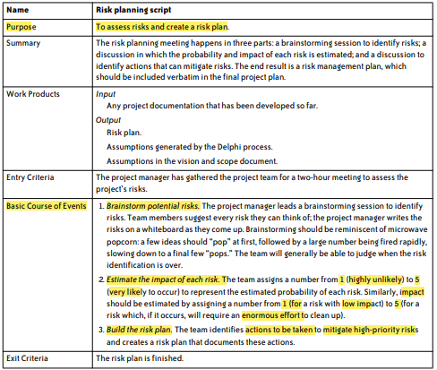
Risk Plan Script:
Supported By
Powered By

Slide 7
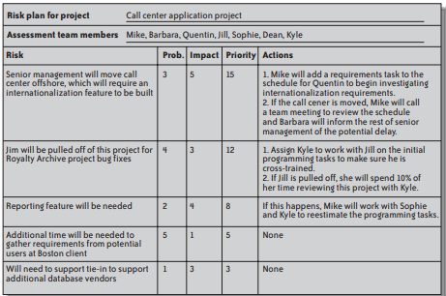
Sample Risk Plan:
Supported By
Powered By

Slide 8
RMMM - Risk Management
Risk Mitigation, Monitoring, and Management (RMMM) plan is a structured approach to identifying, assessing, and managing risks in a project, program, or organization.
It outlines the strategies and procedures for minimizing the impact of potential risks and monitoring and managing them throughout the project or program lifecycle
Supported By
Powered By

Slide 9
RMMM - Risk Mitigation
• Identify potential risks and their likelihood of occurring
• Determine the potential impact or consequence of each risk
• Develop a plan to minimize or avoid risks
• Implement risk mitigation strategies
Supported By
Powered By

Slide 10
RMMM - Risk Monitoring
• Continuously monitor for new risks
• Track progress of risk mitigation strategies
• Collect data and feedback from stakeholders
• Analysis data to identify trends or potential issues
• Communicate findings to relevant parties
• Take corrective action as necessary
Supported By
Powered By

Slide 11
RMMM - Risk Management
• Establish a risk management plan
• Allocate resources and responsibilities for risk management
• Identify and assess risks
• Develop strategies to manage risks
• Implement risk management strategies
• Monitor and review the effectiveness of risk management strategies
Supported By
Powered By

Slide 12
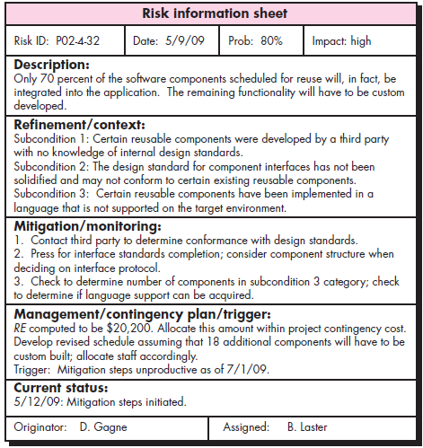
RMMM – Risk Information Sheet (RIS)
Supported By
Powered By

Slide 13
Thank You
Supported By
Powered By

